Slide 1
Basic GWAS in Python

Slide 2
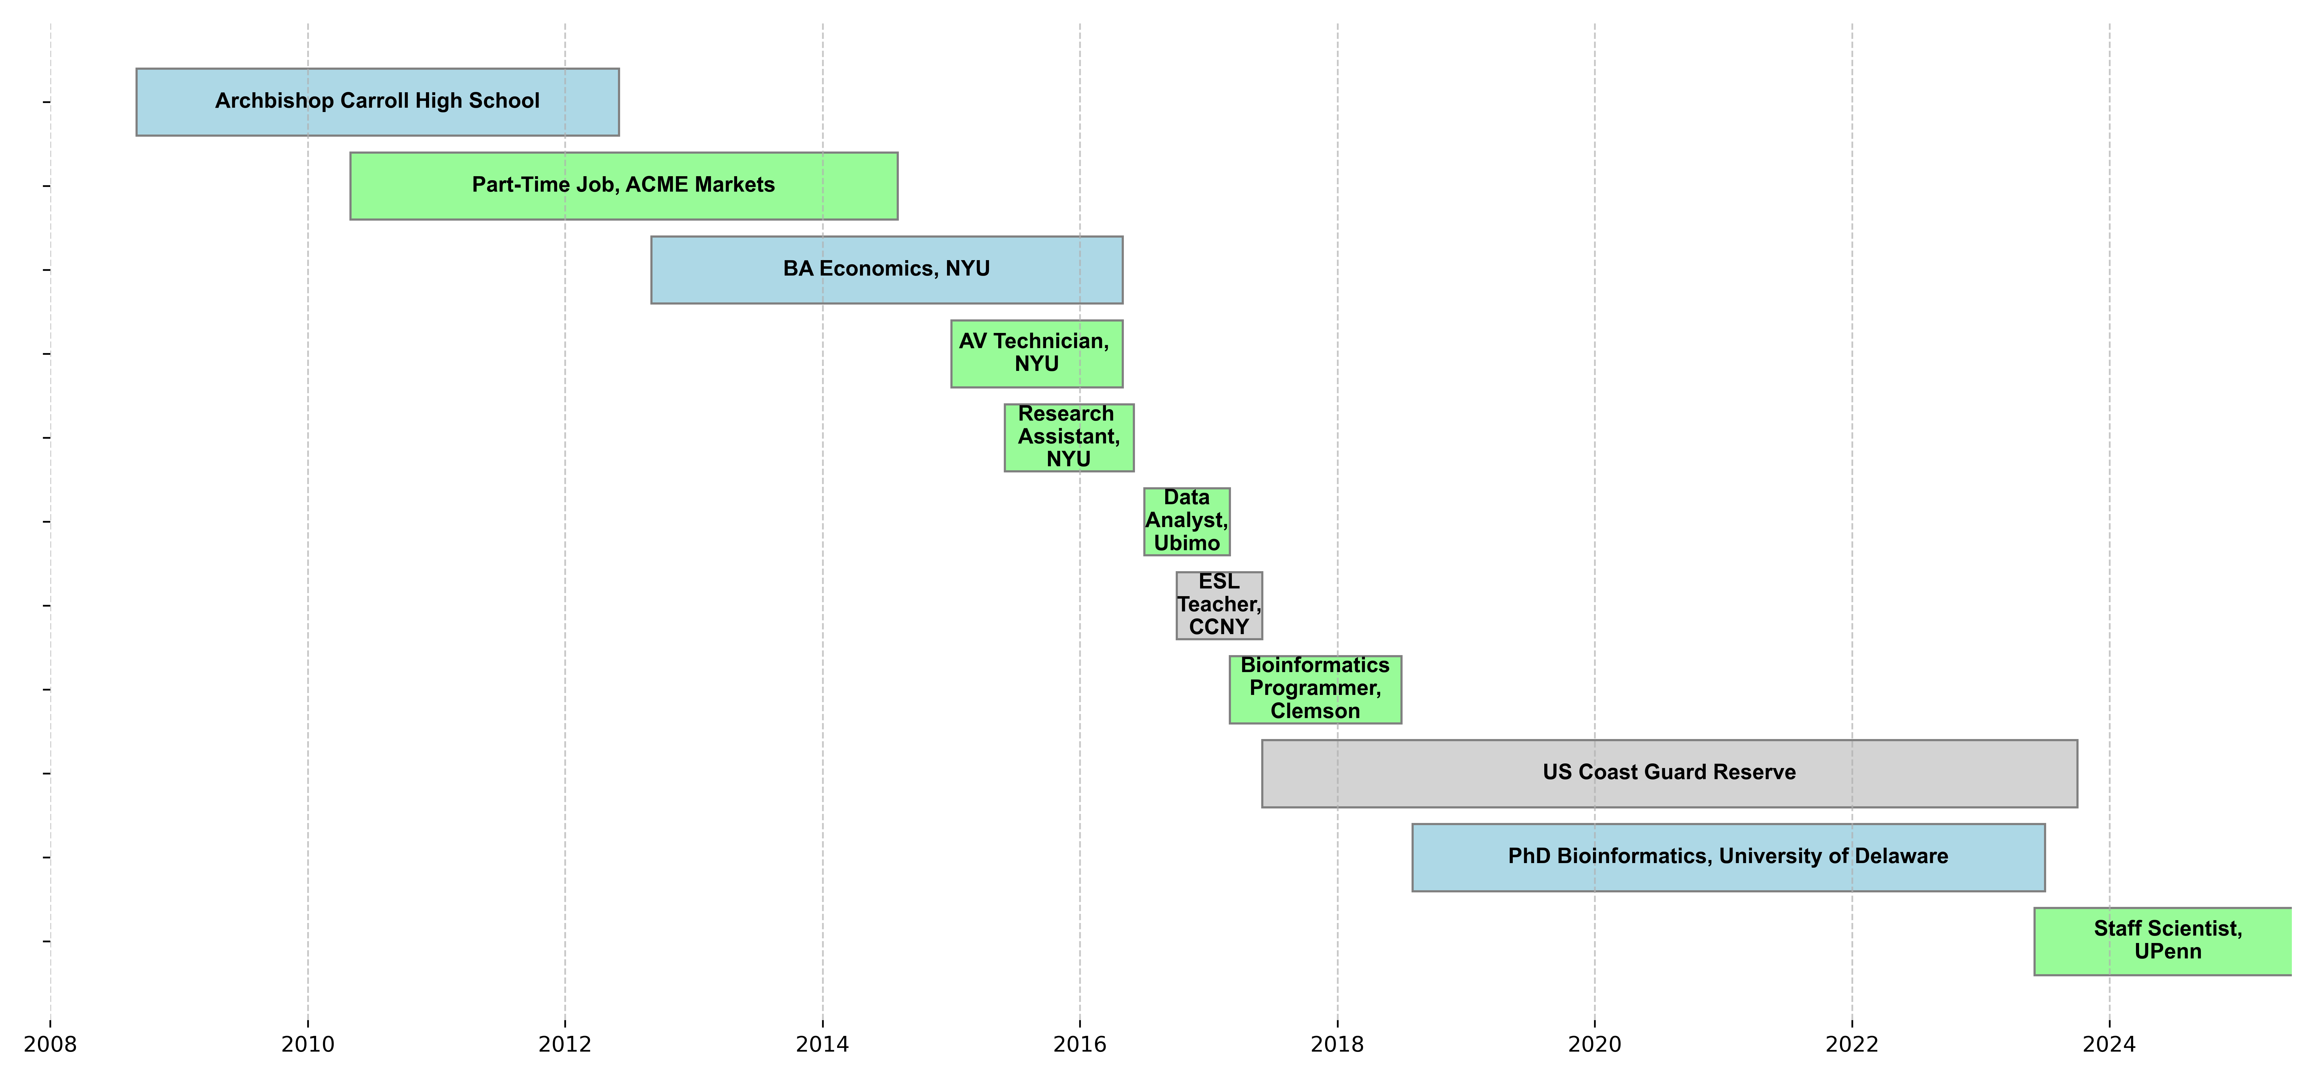
Quick About Me

Slide 3
Epistemic Status
I’m also a beginner on this topic.
Don’t have a solid background in it, but recently was assigned a GWAS project at my job so I’ve been teaching it to myself.
If you hear me say something that sounds incorrect, please correct me!

Slide 4
Review of Mendelian Genetics

Slide 5


Slide 6
X
100%

Slide 7
X
X
100%
75%
25%

Slide 8
Mendelian Genetics
Gene - discrete unit of heredity (example: gene for flower color)
Alleles - different versions of a gene
B: allele for blue flowers
b: allele for white flowers
Each plant has two copies.
If one of each, then dominant one determines color
BB -> blue flowers
bb -> white flowers
Bb -> blue flowers
Genotype: what alleles a plant has
Phenotype: the plant’s color

Slide 9
Mendelian Genetics
If we know the genotypes of two plants, we can predict the color distribution of the offspring from crossing them.
B
B
B
b
b
Bb (blue)
25%
Bb (blue)
25%
B
BB (blue)
25%
Bb (blue)
25%
b
Bb (blue)
25%
Bb (blue)
25%
b
Bb (blue)
25%
bb (white)
25%

Slide 10
Revisiting our previous results…

Slide 11
BB
bb
X
100%
Bb

Slide 12
BB
bb
Bb
Bb
X
X
100%
75%
25%
bb
Bb
25% BB
50% Bb

Slide 13
Molecular Biology Review

Slide 21
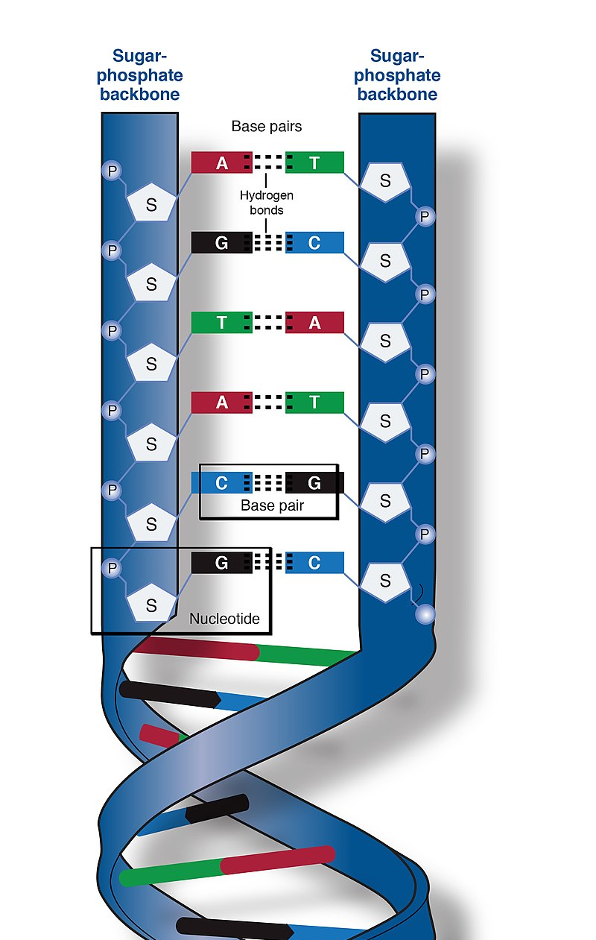
DNA
Four bases:
Adenine
Thymine
Cytosine
Guanine
A and T are complementary
C and G are complementary
Two complementary bases are called a “base pair”
Sequences of base pairs encode information
Image source: https://en.wikipedia.org/wiki/DNA#/media/File:Phosphate_backbone.jpg

Slide 22
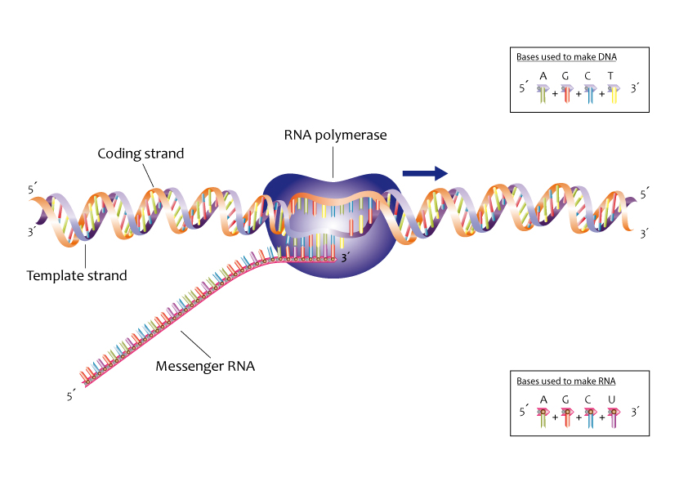
Transcription
Image source: https://commons.wikimedia.org/wiki/File:Process_of_transcription_%2813080846733%29.jpg

Slide 23
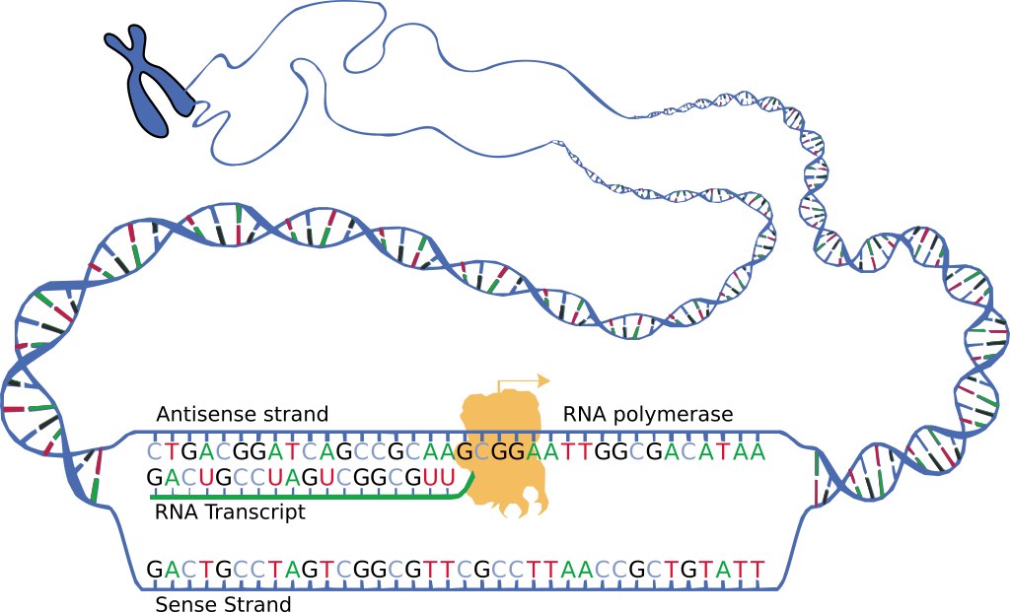
mRNA
Image source: https://en.wikipedia.org/wiki/Messenger_RNA#/media/File:DNA_transcription.svg
Nucleic acid, like DNA
Four bases:
Adenine
Uracil
Cytosine
Guanine
Single stranded (usually)
One of several types of RNA

Slide 24
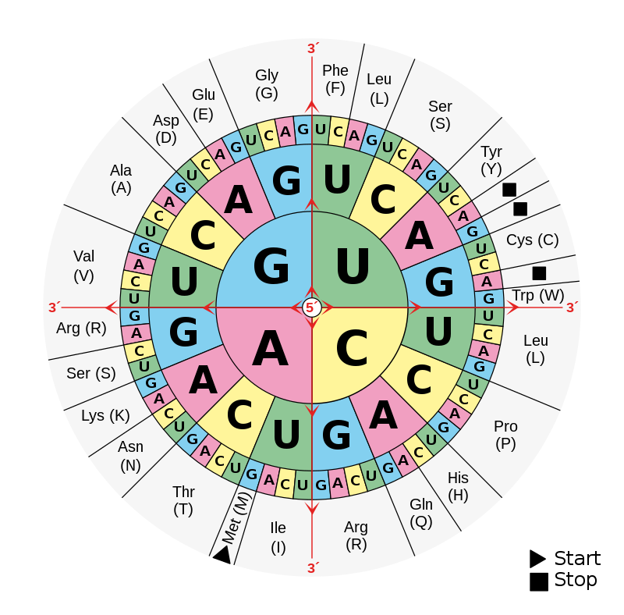
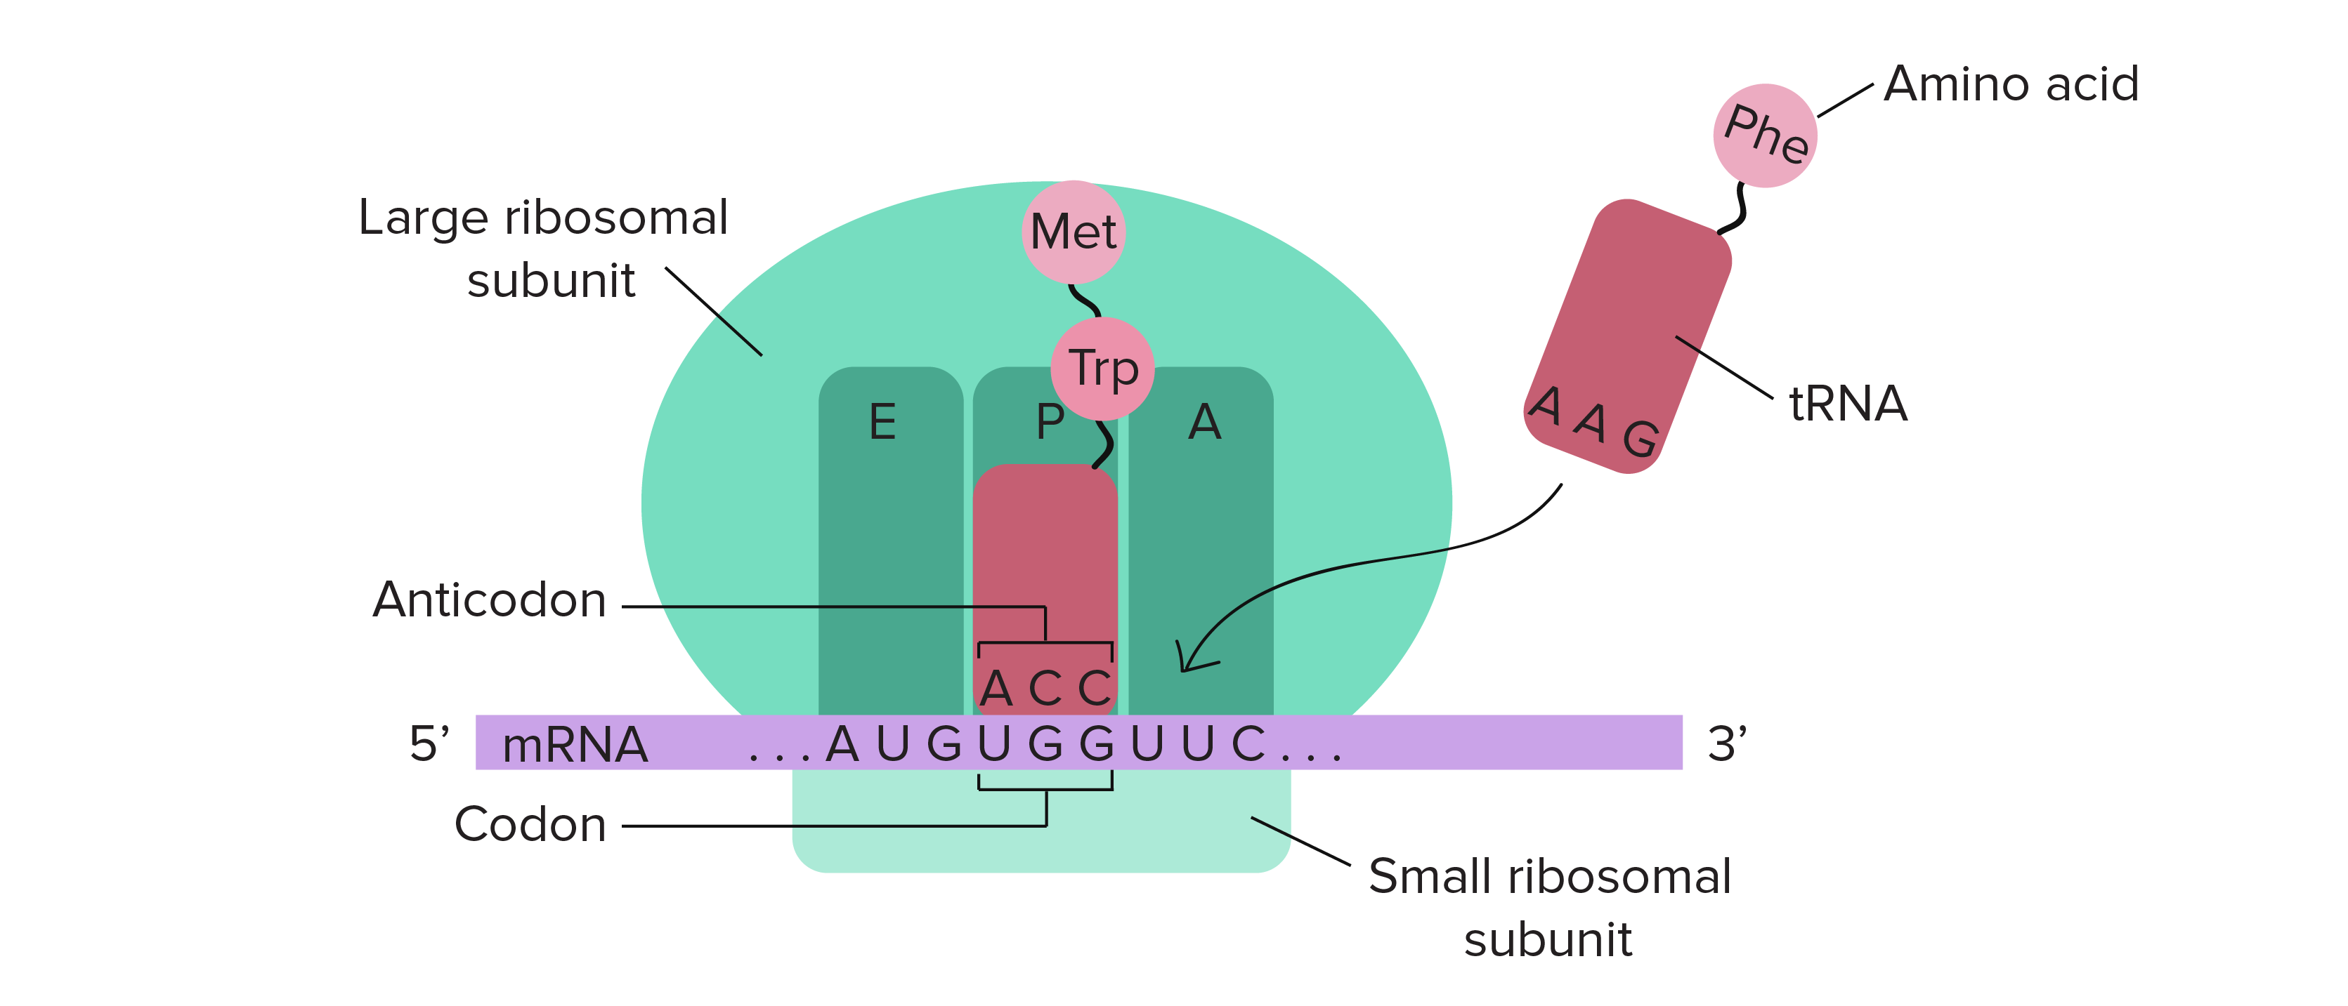
Translation
Image source: https://en.wikipedia.org/wiki/DNA_and_RNA_codon_tables#/media/File:Aminoacids_table.svg
Image source: https://www.khanacademy.org/science/biology/gene-expression-central-dogma/translation-polypeptides/a/the-stages-of-translation

Slide 25
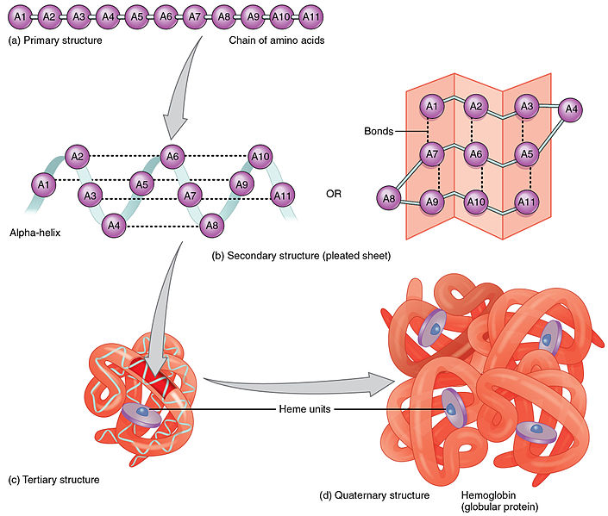
Protein
Image source: https://commons.wikimedia.org/wiki/File:225_Peptide_Bond-01.jpg
Chain of amino acids produced during translation is folded to produce final protein.
Proteins do the work of the cell: catalyzing metabolic reactions, structural support, signaling, regulating cellular processes, etc.

Slide 27
Modern Genetics

Slide 28
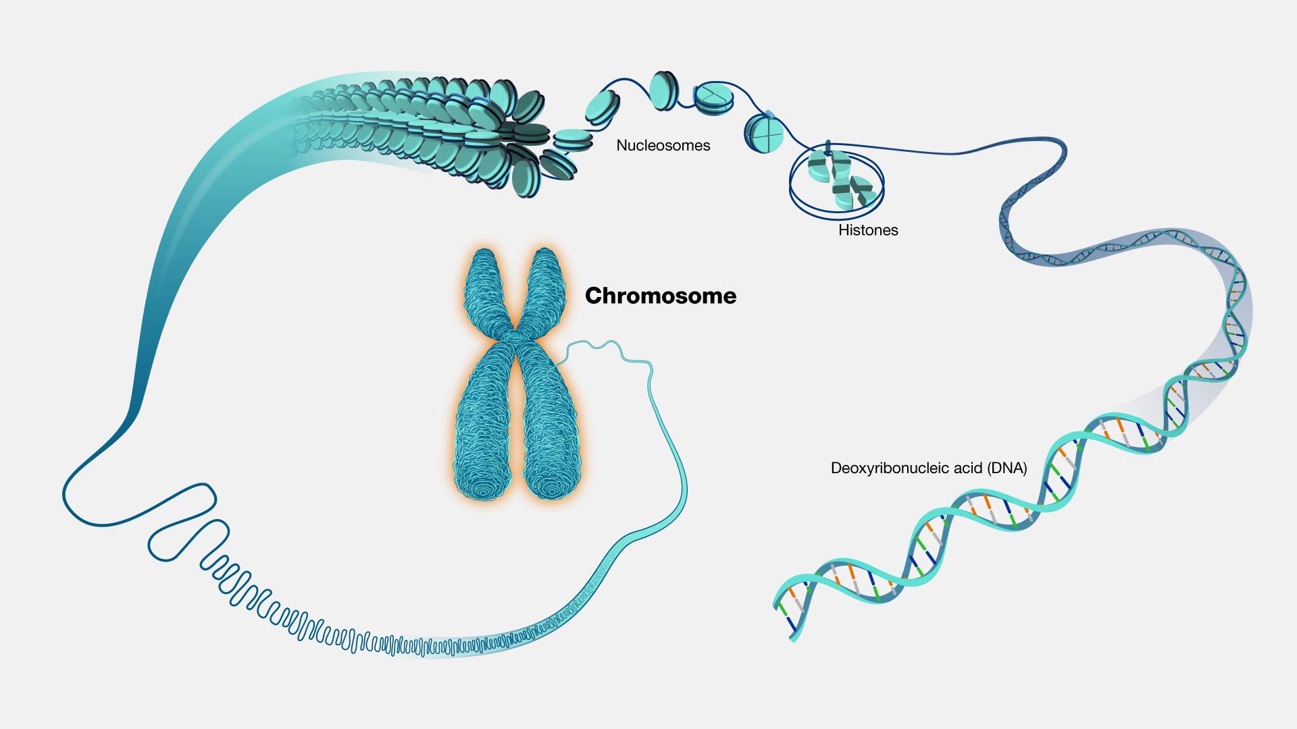
Chromosomes
Image source: https://www.genome.gov/genetics-glossary/Chromosome

Slide 29
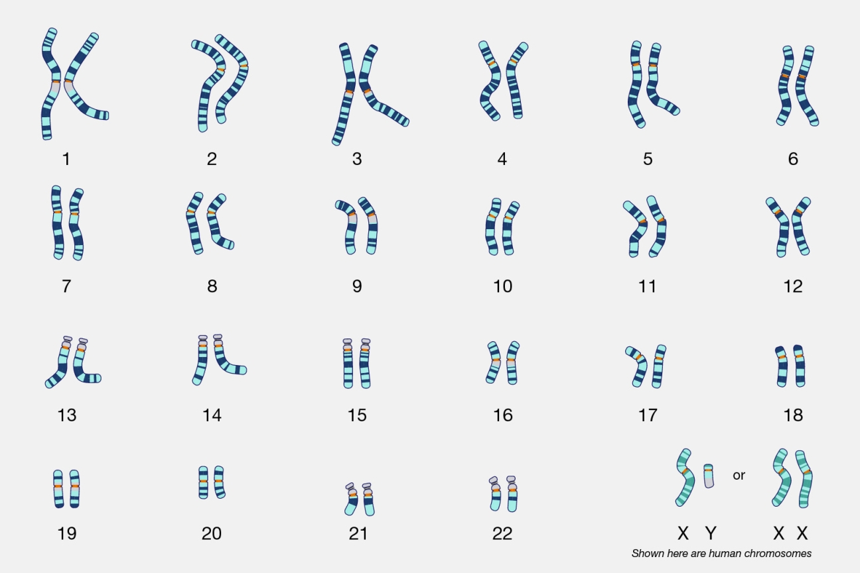
Chromosomes
23 pairs, so 46 total
One copy from mother, one from father
Numbered 1-22, plus sex chromosomes X and Y
Diploid (2n): 46 (two each)
Most of the body’s cells
Haploid (n): 23 (one each)
Gametes (reproductive cells)
Image source:
https://www.genome.gov/genetics-glossary/Karyotype

Slide 30
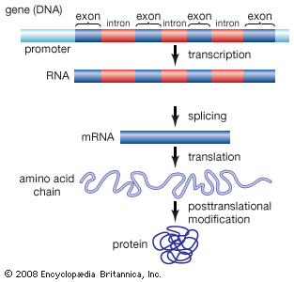
Parts of DNA sequence
Exon - Coding regions are used to specify the string of amino acids going into the protein
Picture isn’t really to scale. Reality is only a small fraction of DNA sequence is exons.
Introns - Non-coding regions that transcribed into mRNA but then spliced out.
Promoter - region where RNA-polymerase and transcription factors bind to gene to initiate transcription.
Image source: https://kids.britannica.com/kids/assembly/view/114928

Slide 31
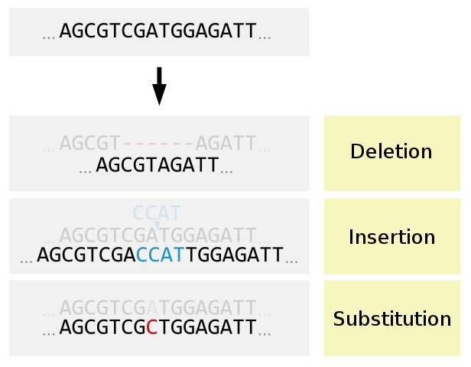
Types of Mutations
Image source: https://commons.wikimedia.org/wiki/File:Deletion_Insertion_Substitution-en.svg/

Slide 32
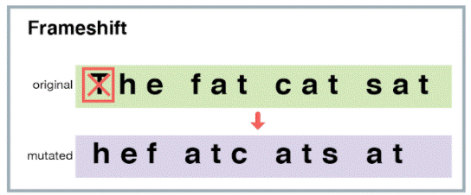
Frameshift from Insertion/Deletion
Image source: https://evolution.berkeley.edu/dna-and-mutations/types-of-mutations/

Slide 33
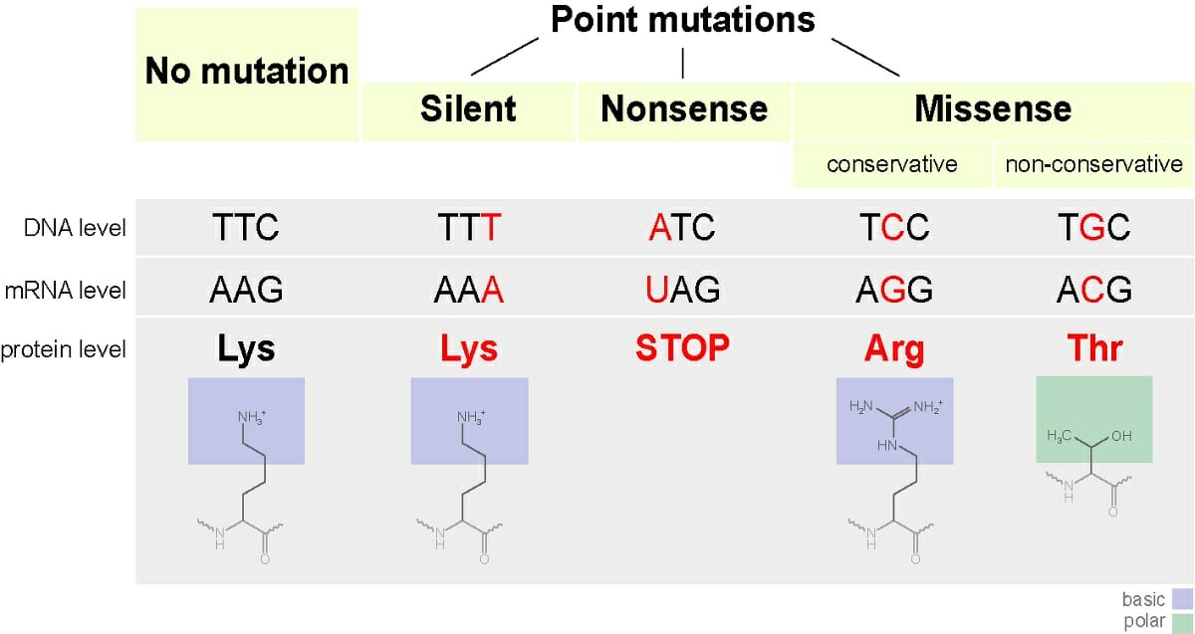
Image source: https://biologydictionary.net/missense-mutation/
Image source: https://en.wikipedia.org/wiki/DNA_and_RNA_codon_tables#/media/File:Aminoacids_table.svg

Slide 34
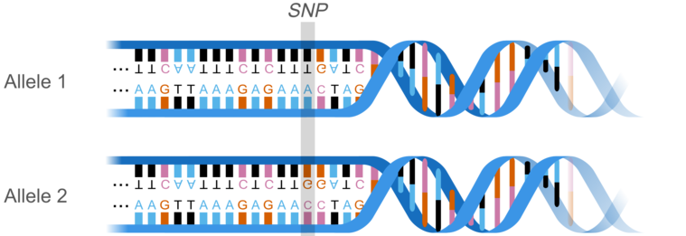
Single-Nucleotide Polymorphisms (SNPs)
Image source: https://commons.wikimedia.org/wiki/File:AllelemodWlocus%26karyotype_eng.png

Slide 35
SNP vs substitution point-mutation
Similar in terms of effect (or non-effect)
Calling a variation a SNP implies that it’s somewhat common, typically found in at least 1% of population.

Slide 36
Modern Genetics
Gene - segment of DNA that contains instructions to produce a product
Alleles - Different versions of a gene
Single-nucleotide polymorphism (SNP) - one base-pair difference between alleles
Where Mendel was right:
Two copies of each gene, one from each parent
Might be two copies of the same allele, or two different alleles
Where it’s more complicated:
Many traits are more complicated than the simple flower example, involving many genes, influence of non-genetic factors, and continuous phenotypes (ex: height)

Slide 37
Project 2: Genome-Wide Association Study (GWAS)

Slide 38

Zombology Basics
Mysterious virus affects people differently
Upon contact with virus, some die (called “normal phenotype”) and some become zombies.
Goal: Analyze genomic data to look for SNPs related to virus response.
Zombie phenotype

Slide 39
Zombie SNP Dataset
48,752 SNPs (actually this is a pretty small dataset)
100 normal samples, 100 zombie samples
Fake data, but similar format to real datasets
snp_id | ref | var | normal_1 | normal_2 | normal_3 | zombie_1 | zombie_2 | zombie_3
chr1:944564 | T | C | 0 | 1 | 1 | 0 | 0 | 0
chr1:950243 | A | C | 2 | 2 | 1 | 1 | 2 | 1
chr1:959842 | C | T | 1 | 2 | 1 | 2 | 1 | 1
chr1:990417 | T | C | 0 | 2 | 2 | 2 | 2 | 2

Slide 40
Quick Statistics Lesson

Slide 41
What is statistics?
Basically, a way of using probability to put a number on coincidences

Slide 42
Figuring out if a coin is fair or weighted
Philosophical musing: in a way, it’s impossible to ever say for sure if a coin is fair or weighted. Even if you flip a coin 1,000,000 times and get heads every time, it could just be a coincidence.
But with statistics, we can at least put a number on how big of a coincidence that would be.

Slide 43
Experiment
First, assume that the coin is fair: 50% chance of heads, 50% chance of tails. (called the null hypothesis)
Experiment: flip a coin 5 times.
Results: 5 heads, 0 tails
What are the chances of a result this extreme happening by coincidence, if the coin is fair?
(0.5 ^ 5) * 2 = 0.0625 = 6.25% chance
(multiplying by 2, because it could have also been 5 tails by coincidence, which would have been equally as extreme)
0.0625 is called a p-value
Is the coin fair? We can’t be sure. But we can put a number on how much of a coincidence would be required to see the results we got if the coin were fair.

Slide 44
p-value
The probability of getting a result as least as extreme as the result you’re seeing, assuming that the null hypothesis is true.

Slide 45
Educational Resources
https://learnbioinformatics.org/

